Slide 1
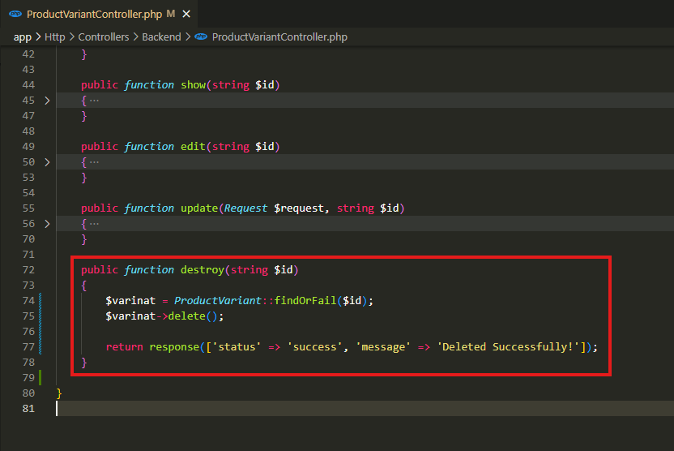
app\Http\Controllers\Backend\ProductVariantController.php

Slide 2
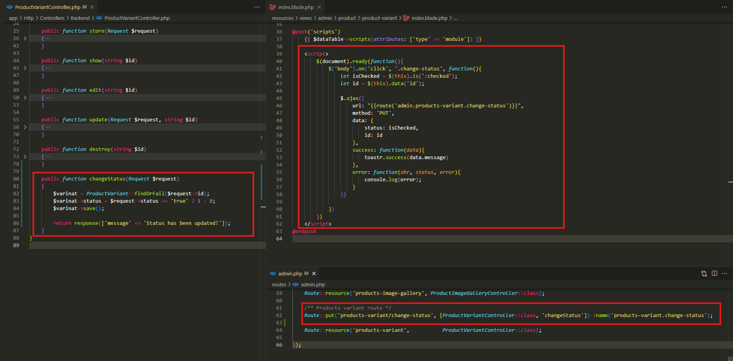
app\Http\Controllers\Backend\ProductVariantController.php
resources\views\admin\product\product-variant\index.blade.php
routes\admin.php

Slide 3
.

